Slide 1
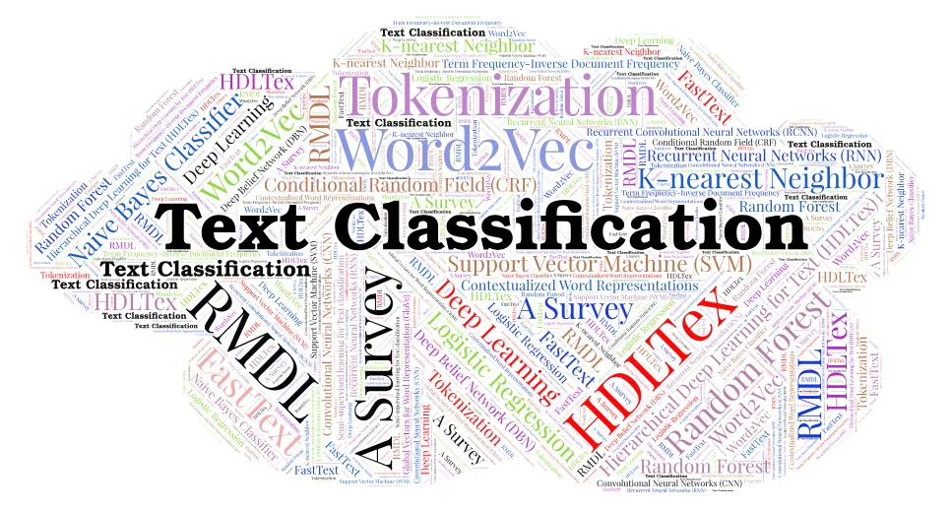
Text Classification and Naïve Bayes
The Task of Text Classification
Notes:
Lecture 6: Text Classification and Naive Bayes

Slide 2
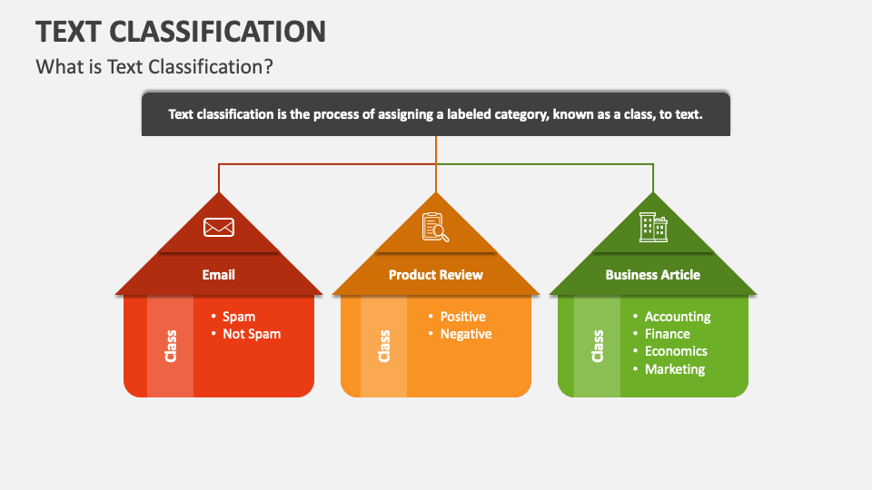
Notes:
What is Text Classification?
Text classification in Natural Language Processing (NLP) refers to the process of categorizing text into one or more predefined categories. This process involves analyzing and understanding the content of a text document, then assigning it to the category or categories that best represent its subject matter or underlying themes. Text classification is a fundamental task in NLP and has a wide range of applications, including spam detection in emails, sentiment analysis in social media posts, topic labeling for documents, and organizing content for information retrieval systems.

Slide 3

Is this spam?
Notes:
What do you think the above mail refers to it is spam or not spam? Text classification for spam detection identifies emails as spam or "not spam" (often called "ham") based on features like: Keywords, Structure and Content. We will be learning this in this chapter.

Slide 4
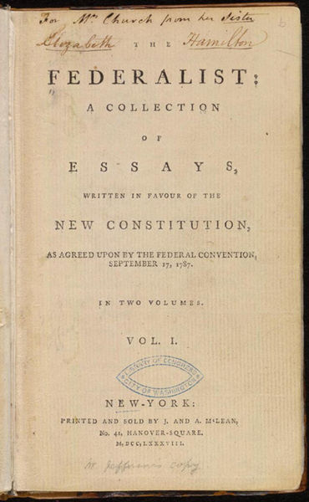
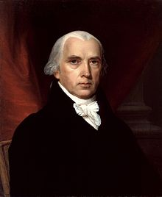
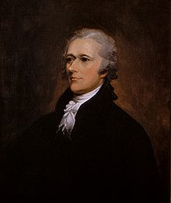
Who wrote which Federalist papers?
1787-8: anonymous essays try to convince New York to ratify U.S Constitution: Jay, Madison, Hamilton.
Authorship of 12 of the letters in dispute
1963: solved by Mosteller and Wallace using Bayesian methods
James Madison
Alexander Hamilton
Notes:
Who wrote which Federalist papers? Identifying this task with the help of text classification. Text classification is a good starting point for author identification, but it should be used cautiously. For definitive authorship determination, it's often used in conjunction with other techniques like stylometry (manual analysis of writing style) or forensic linguistics.

Slide 5
Male or female author?
By 1925 present-day Vietnam was divided into three parts under French colonial rule. The southern region embracing Saigon and the Mekong delta was the colony of Cochin-China; the central area with its imperial capital at Hue was the protectorate of Annam…
Clara never failed to be astonished by the extraordinary felicity of her own name. She found it hard to trust herself to the mercy of fate, which had managed over the years to convert her greatest shame into one of her greatest assets…
Notes:
#1: Saigon. Grey, Anthony
#2: Jerusalem the Golden. Drabble, Margaret
From shlomo argamon
Text classification is a good starting point for author identification, but it should be used cautiously. For definitive authorship determination, it's often used in conjunction with other techniques like stylometry (manual analysis of writing style) or forensic linguistics.

Slide 6
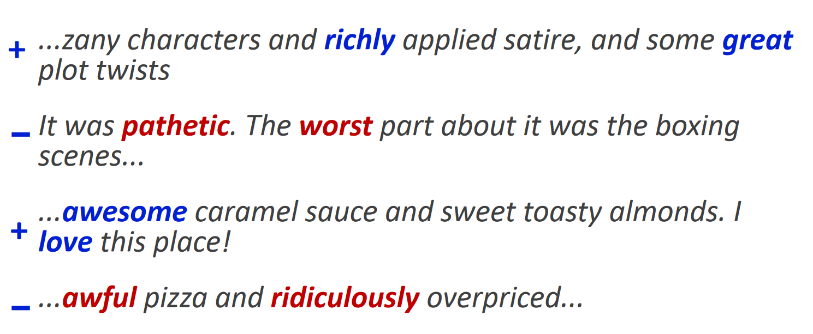


Positive or negative movie review?
Notes:
The above are the examples of movie reviews and are identified as positive or negative with the help of Text Classification. Sentiment analysis aims to categorize text data into sentiment classes, typically positive, negative, or neutral.
Sentiment analysis leverages text classification to automate the process of identifying the emotional tone or opinion conveyed in a piece of text.

Slide 7
What is the subject of this article?
MEDLINE Article
MeSH Subject Category Hierarchy
Antogonists and Inhibitors
Blood Supply
Chemistry
Drug Therapy
Embryology
Epidemiology
…
?
Notes:
Text classification can be used to identify the subject of an article in a few ways:
Predefined Categories:classifier can be trained on a dataset of articles where each article belongs to a specific category (e.g., sports, politics, technology).
Topic Modeling:This technique goes beyond assigning a single category. It identifies latent topics within the text.
Hierarchical Classification:This approach combines the above methods by using a hierarchy of categories.

Slide 8
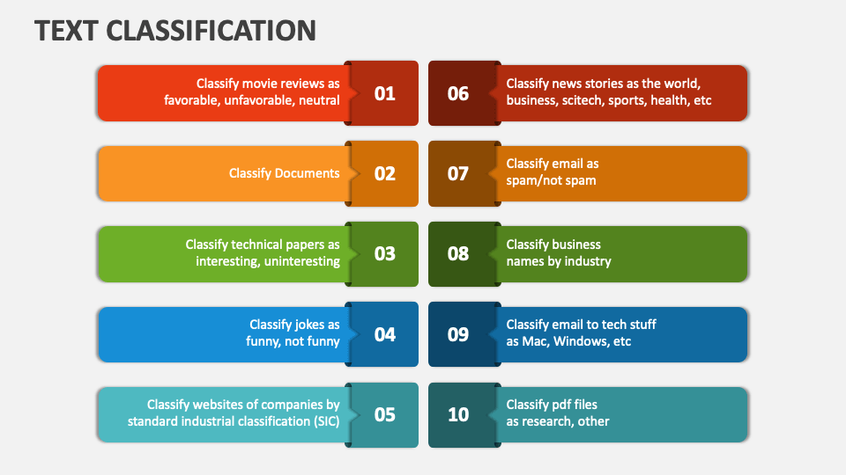
Notes:
Different applications of the Text Classification

Slide 9
Text Classification: definition
Input:
a document d
a fixed set of classes C = {c₁, c₂,…, c_{J}}
Output: a predicted class c ∈ C
Notes:
Input: Text data (documents, emails, messages etc.)
Process:
NLP techniques: Analyzing the text for meaning, including parts of speech, word relationships, and sometimes even sentiment.
Machine Learning (often supervised): Training a model to recognize patterns in labeled data (text with pre-assigned categories). This allows the model to categorize new, unseen text.
Output: Assigning a predefined category label to the text data.

Slide 10
Classification Methods: Hand-coded rules
Rules based on combinations of words or other features
spam: black-list-address OR (“dollars” AND“have been selected”)
Accuracy can be high
If rules carefully refined by expert
But building and maintaining these rules is expensive
Notes:
Unlike machine learning models that learn from data, human experts define a set of rules based on their understanding of the text and the classification task. These rules specify conditions that the text data must meet to be classified into a particular category.
When carefully crafted, these rules can be highly accurate for specific tasks, but building them and maintain these would be expensive

Slide 11
Classification Methods: Supervised Machine Learning
Input:
a document d
a fixed set of classes C = {c₁, c₂,…, c_{J}}
A training set of m hand-labeled documents (d₁,c₁),....,(d_{m},c_{m})
Output:
a learned classifier γ:d → c
Notes:
The provided notation describes the es
d: This represents a document, which is the raw text data you want to classify. C: This is a fixed set of classes, denoted as C = {c1, c2, ..., cJ}. m: This signifies the number of documents in your training set, denoted by m.(d1, c1), ..., (dm, cm): Each element is a pair where: di: This is the i-th document in the training set. ci: This is the corresponding class label for document di. It indicates the pre-assigned category to which document di belongs, chosen from the set C.
Output:
γ (gamma): This represents the learned classifier.

Slide 12
Classification Methods: Supervised Machine Learning
Any kind of classifier
Naïve Bayes
Logistic regression
Support-vector machines
k-Nearest Neighbors
…
Notes:
These are just a few of the many classification algorithms available. The best choice for a specific task depends on the characteristics of your data, the desired level of accuracy, and the need for interpretability.

Slide 13
Naïve Bayes Intuition
Simple (“naïve”) classification method based on Bayes rule
Relies on very simple representation of document
Bag of words
Notes:
This probabilistic classifier calculates the likelihood of a document (d) belonging to a particular class (c) based on Bayes' theorem.
It assumes features (words in this case) are independent of each other, which might not always be true but can be surprisingly effective in practice.

Slide 14
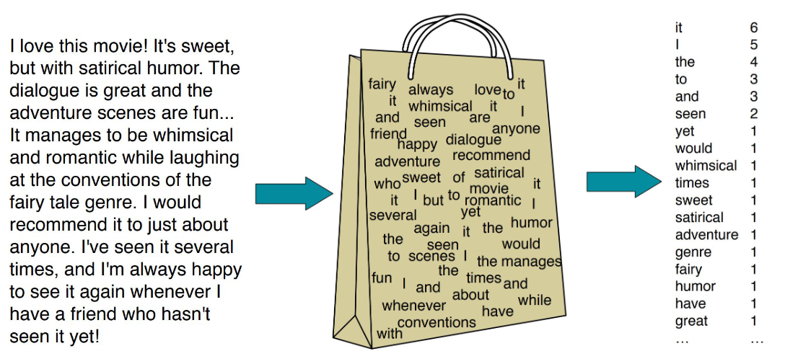
The Bag of Words Representation
Notes:
Bag-of-Words Representation:
This is a simple way to represent a document.
It ignores word order and grammar, focusing only on the presence and frequency of individual words in the document.
Each document is essentially represented as a vector where each element corresponds to a word in the vocabulary, and the value represents the word's frequency in the document.

Slide 15
The bag of words representation: using a subset of words
x love xxxxxxxxxxxxxxxx sweet xxxxxxx satirical xxxxxxxxxx xxxxxxxxxxx great xxxxxxx xxxxxxxxxxxxxxxxxxx fun xxxx xxxxxxxxxxxxx whimsical xxxx romantic xxxx laughing xxxxxxxxxxxxxxxxxxxxxxxxxxxxxxxxxxxxxxxxxxxx recommend xxxxx xxxxxxxxxxxxxxxxxxxxxxxxxxxxxxxx several xxxxxxxxxxxxxxxxx xxxxx happy xxxxxxxxx again xxxxxxxxxxxxxxxxxxxxxxxxxxxxxxxxxxxxxxxxxxxxxxx
γ(
)=c
Notes:
It ignores word order and grammar, focusing only on the presence and frequency of individual words in the document.

Slide 16
The bag of words representation
great | 2
love | 2
recommend | 1
laugh | 1
happy | 1
... | ...
γ(
)=c
Notes:
Each document is essentially represented as a vector where each element corresponds to a word in the vocabulary, and the value represents the word's frequency in the document.

Slide 17
Bag of words for document classification
?
Test
document
Machine Learning
parser
language
label
translation
…
NLP
Garbage
Collection
Planning
GUI
learning
training
algorithm
shrinkage
network...
parser
tag
training
translation
language...
garbage
collection
memory
optimization
region...
planning
temporal
reasoning
plan
language...
...
Notes:
The bag-of-words approach treats a document as a collection of individual words, disregarding their order or grammar.
Imagine a bag filled with random words representing the document's content.
Document Representation:
1.Vocabulary Building: During the training phase, all unique words encountered in the training documents are collected to create a vocabulary.
2.Feature Vector Creation:Each document is then represented as a feature vector. This vector has one element for each word in the vocabulary.

Slide 18
Bayesian Methods
Learning and classification methods based on probability theory.
Bayes theorem plays a critical role in probabilistic learning and classification.
Builds a generative model that approximates how data is produced
Uses prior probability of each category given no information about an item.
Categorization produces a posterior probability distribution over the possible categories given a description of an item.
Notes:
Benefits of Probabilistic Learning and Classification:
Principled Approach: This method provides a statistically sound foundation for classification decisions.
Flexibility: It can handle various data types and incorporate domain knowledge through prior probabilities.
Interpretability: Posterior probabilities offer insights into the model's confidence in its classification.

Slide 19
Bayes’ Rule for text classification
For a document d and a class c
Notes:
P(c|d) = ( P(d|c) * P(c) ) / P(d)
To classify a document, we calculate the posterior probability (P(c|d)) for each possible class (c).
The document is assigned to the class with the highest posterior probability.

Slide 20
Naïve Bayes Classifier (I)
MAP is “maximum a posteriori” = most likely class
Bayes Rule
Dropping the denominator
Notes:
P(c|d): Posterior probability - The probability of a class (c) occurring given a document (d). This is what we want to determine for classification.
P(d|c): Likelihood - The probability of a document (d) occurring given a class (c). This reflects how well the document aligns with the features of class c.
P(c): Prior probability - The probability of a class (c) occurring regardless of any document. This can be derived from the frequency of class labels in the training data.
P(d): Total probability of the document (usually assumed constant across classes).

Slide 21
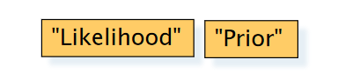
Naïve Bayes Classifier (II)
Document d represented as features x1..xn

Slide 22
Naïve Bayes Classifier (IV)
O(|X|^{n}•|C|) parameters
How often does this class occur?
Could only be estimated if a very, very large number of training examples was available.
We can just count the relative frequencies in a corpus

Slide 23
The Naïve Bayes Classifier
Flu
X₁
X₂
X₃
X₄
X₅
runnynose
sinus
cough
fever
muscle-ache
Conditional Independence Assumption: features detect term presence and are independent of each other given the class:
Notes:
Naive Bayes classifiers assume that the features used for classification (typically word presence or absence in a document) are independent of each other given the class label. The image you sent shows a table with features like "runny nose," "sinus," "cough," "fever," and "muscle ache" listed under the category "Flu." This directly reflects the conditional independence assumption

Slide 24
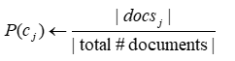
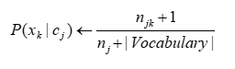
Naive Bayes: Learning Running example: document classification
From training corpus, extract Vocabulary
Calculate required P(c_{j}) and P(x_{k} | c_{j}) terms
For each c_{j} in C do
docs_{j} ← subset of documents for which the target class is c_{j}
Text_{j} ← single document containing all docs_{j}
for each word x_{k} in Vocabulary
n_{jk} ← number of occurrences of x_{k} in Text_{j}
n_{j}← number of words in Text_{j}
Notes:
This code snippet calculates the essential word counts (njk and nj) needed to estimate the conditional probability P(xk | cj) for each word in the vocabulary and for each class during the training phase of the Naive Bayes classifier.

Slide 25
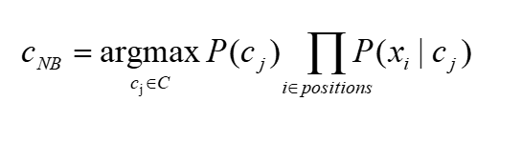
Naive Bayes: Classifying
positions ← all word positions in current document which contain tokens found in Vocabulary
Return c_{NB}, where
Notes:
Without more context about the overall implementation and the purpose of the cNB function, it's difficult to say definitively what this code snippet is intended to do. It's likely related to feature engineering but might be an error or incomplete in the context of standard Naive Bayes with a bag-of-words approach.

Slide 26
Two Naive Bayes Models
Model 1: Multivariate Bernoulli
One feature X_{w} for each word in dictionary
X_{w} = true in document d if w appears in d
Naive Bayes assumption:
Given the document’s topic, appearance of one word in the document tells us nothing about chances that another word appears
This is the model used in the binary independence model in classic probabilistic relevance feedback on hand-classified data (Maron in IR was a very early user of NB)
Notes:
Multivariate Bernoulli: This variant of Naive Bayes assumes each feature (word) is a binary variable.. The Multivariate Bernoulli Naive Bayes model with a single feature per word offers a simple and efficient approach for text classification, making it a valuable tool, especially in early information retrieval systems like PRF. While the conditional independence assumption might not always hold true, it can still achieve good results in many practical scenarios.

Slide 27
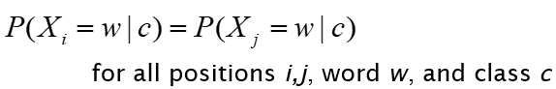
Model 2: Multinomial = Class conditional unigram
One feature X_{i} for each word position in document
feature’s values are all words in dictionary
Value of X_{i} is the word in position i
Naïve Bayes assumption:
Given the document’s topic, word in one position in the document tells us nothing about words in other positions
Second assumption:
Word appearance does not depend on position
Just have one multinomial feature predicting all words
Notes:
Multinomial: This variant assumes a multinomial distribution for each feature, where each outcome represents a word in the vocabulary. The Multinomial Naive Bayes model offers a more nuanced approach compared to the Bernoulli model. It captures the specific words appearing in a document but still relies on the assumption of word independence, which might not always hold true (word order can be meaningful). This model can be effective for document classification tasks where word order might not be crucial but the specific words used are informative.

Slide 28
Multivariate Bernoulli V/s Multinomial Naive Bayes
Multivariate Bernoulli Naive Bayes:
This model is used when features can be binary (i.e., they are either present or not). It's suitable for datasets where it's important to capture the presence/absence of a feature.
In image processing, it could be used when the features of interest are simple and binary, such as whether a pixel is above a certain threshold of intensity or not.
Multinomial Naive Bayes:
suited for NLP tasks that involve text data where the frequency of the words is important like
Text Classification, Spam Filtering, Sentiment Analysis, Topic Modeling, Language Detection, Document Categorization for Information Retrieval
Notes:
Multivariate Bernoulli when the fact of the presence or absence of a feature is informative, and Multinomial Naive Bayes when the frequency of the features is important for your classification task.

Slide 29
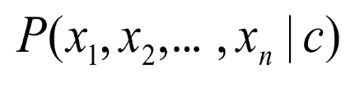
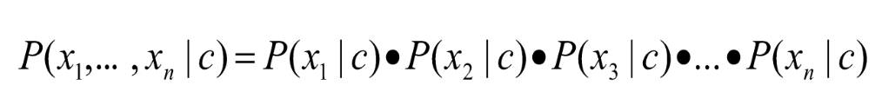
Multinomial Naïve Bayes Independence Assumptions
we will be learning MultinomialNB as it is considered the best for Text Classification
Bag of Words assumption: Assume position doesn’t matter
Conditional Independence: Assume the feature probabilities P(x_{i}|c_{j}) are independent given the class c.
Notes:
The crucial difference between this Multinomial model and the previous Multivariate Bernoulli model is how features are defined.
Multivariate Bernoulli: Separate features for each word, capturing its presence/absence.
Multinomial: Single feature per position, capturing the actual word at that position.

Slide 30
Multinomial Naïve Bayes Classifier

Slide 31
Applying Multinomial Naive Bayes Classifiers to Text Classification
positions ← all word positions in test document

Slide 32
Learning the Multinomial Naïve Bayes Model
Sec.13.3
First attempt: maximum likelihood estimates
simply use the frequencies in the data
Notes:
Count (wi, Cj): This represents the number of times word wi appears in documents belonging to class cj (basically a count of word occurrences). P(w; c) = Count(wi, Cj) / Σ Count(wi, Cj): This formula calculates the estimated probability of word wi appearing in a document of class c. It essentially divides the count of word wi in class cj by the total count of word wi across all classes (Σ Count(wi, Cj)).

Slide 33
Parameter estimation
fraction of times word w_{i} appears
among all words in documents of topic c_{j}
Create mega-document for topic j by concatenating all docs in this topic
Use frequency of w in mega-document
Notes:
The table serves as a helpful visualization of how MLE can be applied to estimate word probabilities (P(wi | cj)) based on word frequencies (counts) in the training data. These probabilities are then used by the Naive Bayes classifier to predict the class label for new documents.

Slide 34
Problem with Maximum Likelihood
Sec.13.3
What if we have seen no training documents with the word fantastic and classified in the topic positive (thumbs-up)?
Zero probabilities cannot be conditioned away, no matter the other evidence!
Notes:
MLE provides a simple and efficient way to estimate the probabilities required for Naive Bayes classification. By using word frequencies in the training data, MLE helps the model learn the characteristics of different document categories.

Slide 35
Multinomial Naïve Bayes: Learning
From training corpus, extract Vocabulary
Calculate P(c_{j}) terms
For each c_{j} in C do
docs_{j} ← all docs with class =c_{j}
Calculate P(w_{k} | c_{j}) terms
Text_{j} ← single doc containing all docs_{j}
For each word w_{k} in Vocabulary
n_{k} ← # of occurrences of w_{k} in Text_{j}
Notes:
This code snippet calculates the essential word counts (njk and nj) needed to estimate the conditional probability P(xk | cj) for each word in the vocabulary and for each class during the training phase of the Naive Bayes classifier.

Slide 36
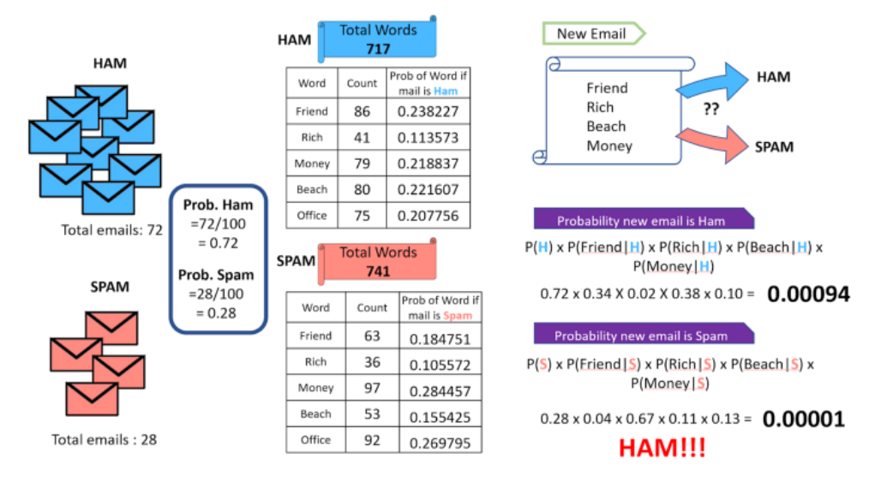
Notes:
Example for spam email detection with naïve bayes

Slide 37
The Zero frequency problem:
If an individual class label is missing, then the frequency-based probability estimate will be zero. And we will get a zero when all the probabilities are multiplied.
In our above example, if the word ‘office’ is missing from the list of words in spam, whenever we see a new email that consists of the word ‘office’ it will always be considered a ham, no matter how ‘spammy’ the other words are.
Notes:
In Naive Bayes, the posterior probability (P(c | d)), which determines the most likely class for a new document (d), is calculated by multiplying class priors (P(c)) and word probabilities (P(wi | cj)) across all features (words).
If P(wi | cj) for a word (wi) in a class (cj) is zero, the entire product for that class becomes zero, effectively removing that class from consideration.

Slide 38
Solution: Laplace (add-1) smoothing: unknown words
Add one extra word to the vocabulary, the “unknown word” w_{u}
Notes:
Laplace Smoothing (most common approach):
This method adds a small value (typically 1) to both the numerator (count of the word in the class) and the denominator (total word count in the class) when estimating P(wi | cj).
This ensures no probability becomes zero and introduces a slight bias towards words seen less frequently.

Slide 39
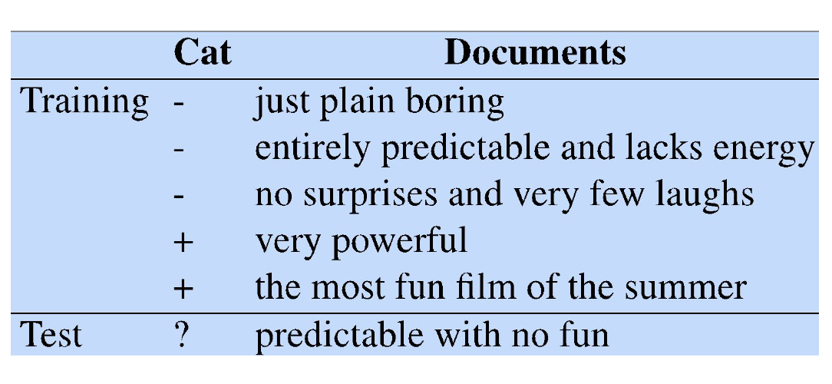
Sentiment and Binary Naive Bayes
Let's do a worked sentiment example!
Notes:
Sentiment Classification Example:
In sentiment analysis, the goal is to classify text data (e.g., reviews, social media posts) into sentiment categories like positive, negative, or neutral.

Slide 40
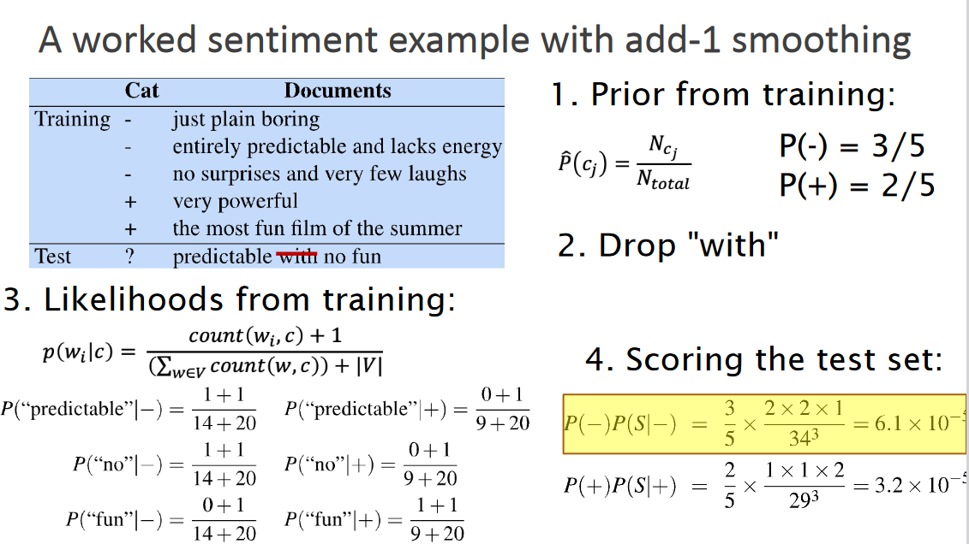
Notes:
sentiment analysis example with Naive Bayes and add-1 smoothing. It appears to represent a binary sentiment classification task, likely to classify documents as positive or negative. Here's a breakdown of the information in the image:
Task: Sentiment Analysis with Naive Bayes Classification: Binary (Positive or Negative) Smoothing: Add-1 Smoothing (a technique to address zero probabilities)

Slide 41
Optimizing for sentiment analysis
For tasks like sentiment, word occurrence seems to be more important than word frequency.
◦ The occurrence of the word fantastic tells us a lot
◦ The fact that it occurs 5 times may not tell us much more.
Binary multinominal naive bayes, or binary NB
◦ Clip our word counts at 1
◦ Note: this is different than Bernoulli naive bayes; see the
textbook notes at the end of the chapter.
Notes:
Binary Multinomial Naive Bayes (Binary NB) provides a practical approach for sentiment analysis by focusing on word occurrence (presence/absence) and simplifying the model compared to standard Multinomial NB. This can be particularly effective when considering that, in sentiment analysis, the presence of specific words can be more informative than their exact frequency.

Slide 42
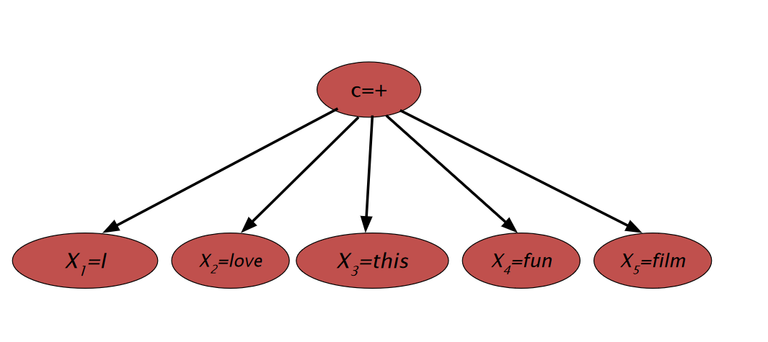
Generative Model for Multinomial Naïve Bayes Example 1

Slide 43
Naïve Bayes and Language Modeling
Naïve bayes classifiers can use any sort of feature
URL, email address, dictionaries, network features
But if, as in the previous slides
We use only word features
we use all of the words in the text (not a subset)
Then
Naïve bayes has an important similarity to language modeling.

Slide 44
Each class = a unigram language model
Sec.13.2.1
Assigning each word: P(word | c)
Assigning each sentence: P(s|c)=Π P(word|c)
Class pos
0.1 I
0.1 love
0.01 this
0.05 fun
0.1 film
…
I
love
this
fun
film
0.1
0.1
.05
0.01
0.1
P(s | pos) = 0.0000005
Notes:
The concept of assigning probabilities to words and sentences in Naive Bayes classification is captured well in the image you sent. The equation P(s | c) = Π P(word | c) attempts to calculate the probability of an entire sentence (s) belonging to class c.

Slide 45
Naïve Bayes as a Language Model
Sec.13.2.1
Which class assigns the higher probability to s?
Model pos
Model neg
0.2 I
0.001 love
0.01 this
0.005 fun
0.1 film
0.1 I
0.1 love
0.01 this
0.05 fun
0.1 film
I
love
this
fun
film
0.1
0.1
0.01
0.05
0.1
0.2
0.001
0.01
0.005
0.1
P(s|pos) > P(s|neg)
Notes:
While the image provides a mathematical notation for sentence probability, it's important to understand the limitations due to the conditional independence assumption in Naive Bayes. Naive Bayes typically focuses on document-level classification or uses word n-grams to account for some sentence structure information.

Slide 46
Example 2:
 | Doc | Words | Class
Training | 1 | Chinese Beijing Chinese | c
 | 2 | Chinese Chinese Shanghai | c
 | 3 | Chinese Macao | c
 | 4 | Tokyo Japan Chinese | j
Test | 5 | Chinese Chinese Chinese Tokyo Japan | ?
Priors:
P(c)=
P(j)=
3
4
1
Choosing a class:
P(c|d5)
P(j|d5)
4
3/4 * (3/7)³ * 1/14 * 1/14
≈ 0.0003
Conditional Probabilities:
P(Chinese|c) =
P(Tokyo|c) =
P(Japan|c) =
P(Chinese|j) =
P(Tokyo|j) =
P(Japan|j) =
(5+1) / (8+6) = 6/14 = 3/7
(0+1) / (8+6) = 1/14
1/4 * (2/9)³ * 2/9 * 2/9
≈ 0.0001
(0+1) / (8+6) = 1/14
(1+1) / (3+6) = 2/9
(1+1) / (3+6) = 2/9
(1+1) / (3+6) = 2/9
Notes:
Naive Bayes with Laplace smoothing can be used to classify the sentiment of a document by calculating the likelihoods of the document belonging to the positive or negative class based on word probabilities. The class with the higher likelihood is assigned as the sentiment label.

Slide 47
Naïve Bayes in Spam Filtering
SpamAssassin Features:
Mentions Generic Viagra
Online Pharmacy
Mentions millions of (dollar) ((dollar) NN,NNN,NNN.NN)
Phrase: impress ... girl
From: starts with many numbers
Subject is all capitals
HTML has a low ratio of text to image area
One hundred percent guaranteed
Claims you can be removed from the list
'Prestigious Non-Accredited Universities'
http://spamassassin.apache.org/tests_3_3_x.html
Notes:
SpamAssassin uses a combination of content analysis, header checks, structural analysis, and potentially blacklisted terms to create a score for an email. If the score exceeds a certain threshold, the email is classified as spam. These features are just a few examples, and SpamAssassin offers a vast range of tests to improve spam detection accuracy.

Slide 48
Summary: Naive Bayes is Not So Naive
Very Fast, low storage requirements
Robust to Irrelevant Features
Irrelevant Features cancel each other without affecting results
Very good in domains with many equally important features
Decision Trees suffer from fragmentation in such cases – especially if little data
Optimal if the independence assumptions hold: If assumed independence is correct, then it is the Bayes Optimal Classifier for problem
A good dependable baseline for text classification
But we will see other classifiers that give better accuracy

Slide 49
Text Classification and Naïve Bayes
Evaluation :Precision, Recall, and the F measure
Notes:
some common evaluation metrics used for text classification with Naive Bayes:

Slide 50
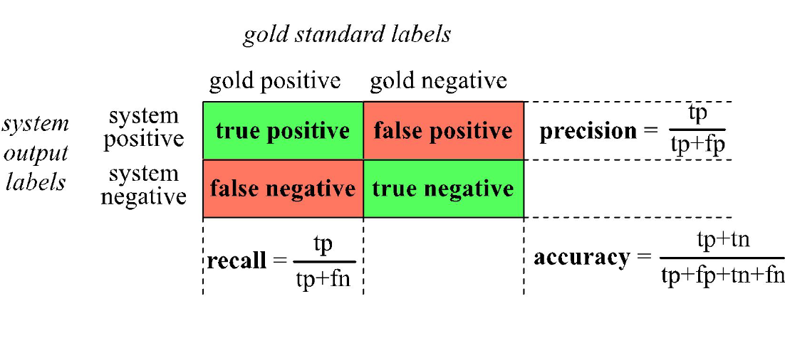
The 2-by-2 contingency table
Notes:
confusion matrix for a text classification task, likely sentiment analysis trying to classify documents as positive or negative. A confusion matrix helps visualize the performance of a classification model
Rows: Represent the actual sentiment labels of the documents in the test data (ground truth).Columns: Represent the sentiment labels predicted by the model for the test data

Slide 51

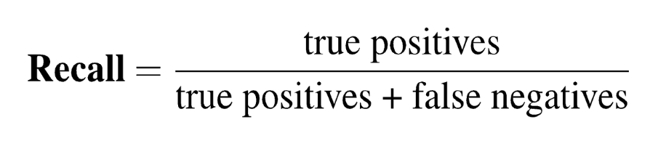
Precision and recall
Precision: % of selected items that are correct Recall: % of correct items that are selected
Notes:
Precision:
Precision measures the proportion of documents classified as a particular class that actually belong to that class. It's calculated as the number of true positives divided by the sum of true positives and false positives (documents incorrectly classified as belonging to the class).
Recall:
Recall measures the proportion of documents belonging to a particular class that are correctly classified by the model. It's calculated as the number of true positives divided by the sum of true positives and false negatives (documents belonging to the class that were classified as something else).

Slide 52
A combined measure: F
A combined measure that assesses the P/R tradeoff is F measure (weighted harmonic mean):
The harmonic mean is a very conservative average; see IIR § 8.3
People usually use balanced F1 measure
i.e., with β = 1 (that is, α = ½): F = 2PR/(P+R)
Notes:
The F measure (also known as the F-score or F1 score) is a combined measure that assesses the precision (P) and recall (R) tradeoff and is a type of weighted harmonic mean. The F1 score is particularly useful when the class distribution is uneven and when false positives and false negatives have a similar cost. It is often used in NLP tasks such as text classification, where the goal is to assign a document or a piece of text to one or more categories or classes.

Slide 53
More Than Two Classes: Sets of binary classifiers
Sec.14.5
Dealing with any-of or multivalue classification
A document can belong to 0, 1, or >1 classes.
For each class c∈C
Build a classifier γ_{c} to distinguish c from all other classes c’ ∈C
Given test doc d,
Evaluate it for membership in each class using each γ_{c}
d belongs to any class for which γ_{c} returns true

Slide 54
More Than Two Classes: Sets of binary classifiers
Sec.14.5
One-of or multinomial classification
Classes are mutually exclusive: each document in exactly one class
For each class c∈C
Build a classifier γ_{c} to distinguish c from all other classes c’ ∈C
Given test doc d,
Evaluate it for membership in each class using each γ_{c}
d belongs to the one class with maximum score

Slide 55
Evaluation: Classic Reuters-21578 Data Set
Sec. 15.2.4
Most (over)used data set, 21,578 docs (each 90 types, 200 toknens)
9603 training, 3299 test articles (ModApte/Lewis split)
118 categories
An article can be in more than one category
Learn 118 binary category distinctions
Average document (with at least one category) has 1.24 classes
Only about 10 out of 118 categories are large
Earn (2877, 1087)
Acquisitions (1650, 179)
Money-fx (538, 179)
Grain (433, 149)
Crude (389, 189)
Trade (369,119)
Interest (347, 131)
Ship (197, 89)
Wheat (212, 71)
Corn (182, 56)
Common categories
(#train, #test)
Notes:
The Reuters-21578 dataset is a widely used collection of newswire documents for text classification research. It's a benchmark dataset commonly used to evaluate various algorithms for text classification tasks, including sentiment analysis, topic modeling, and spam filtering.

Slide 56
Reuters Text Categorization data set (Reuters-21578) document
Sec. 15.2.4
<REUTERS TOPICS="YES" LEWISSPLIT="TRAIN" CGISPLIT="TRAINING-SET" OLDID="12981" NEWID="798">
<DATE> 2-MAR-1987 16:51:43.42</DATE>
<TOPICS><D>livestock</D><D>hog</D></TOPICS>
<TITLE>AMERICAN PORK CONGRESS KICKS OFF TOMORROW</TITLE>
<DATELINE> CHICAGO, March 2 - </DATELINE><BODY>The American Pork Congress kicks off tomorrow, March 3, in Indianapolis with 160 of the nations pork producers from 44 member states determining industry positions on a number of issues, according to the National Pork Producers Council, NPPC.
Delegates to the three day Congress will be considering 26 resolutions concerning various issues, including the future direction of farm policy and the tax law as it applies to the agriculture sector. The delegates will also debate whether to endorse concepts of a national PRV (pseudorabies virus) control and eradication program, the NPPC said.
A large trade show, in conjunction with the congress, will feature the latest in technology in all areas of the industry, the NPPC added. Reuter
&#3;</BODY></TEXT></REUTERS>
Notes:
single document in the Reuters Text Categorization dataset (Reuters-21578) typically follows a simple format with several key components:
Document ID, Text, Class labels (Optional),
Delimiters: Specific symbols or characters might separate the document ID, text, and class labels.

Slide 57
Confusion matrix c
For each pair of classes <c₁,c₂> how many documents from c₁ were incorrectly assigned to c₂?
c_{3,2}: 90 wheat documents incorrectly assigned to poultry
Docs in test set | Assigned UK | Assigned poultry | Assigned wheat | Assigned coffee | Assigned interest | Assigned trade
True UK | 95 | 1 | 13 | 0 | 1 | 0
True poultry | 0 | 1 | 0 | 0 | 0 | 0
True wheat | 10 | 90 | 0 | 1 | 0 | 0
True coffee | 0 | 0 | 0 | 34 | 3 | 7
True interest | - | 1 | 2 | 13 | 26 | 5
True trade | 0 | 0 | 2 | 14 | 5 | 10

Slide 58
Per class evaluation measures
Sec. 15.2.4
Recall:
Fraction of docs in class i classified correctly:
Precision:
Fraction of docs assigned class i that are actually about class i:
Accuracy: (1 - error rate)
Fraction of docs classified correctly:

Slide 59
Micro- vs. Macro-Averaging
Sec. 15.2.4
If we have more than one class, how do we combine multiple performance measures into one quantity?
Macroaveraging: Compute performance for each class, then average.
Microaveraging: Collect decisions for all classes, compute contingency table, evaluate.

Slide 60
Micro- vs. Macro-Averaging: Example
Sec. 15.2.4
Class 1
Class 2
Micro Ave. Table
 | Truth: yes | Truth: no
Classifier: yes | 10 | 10
Classifier: no | 10 | 970
 | Truth: yes | Truth: no
Classifier: yes | 90 | 10
Classifier: no | 10 | 890
 | Truth: yes | Truth: no
Classifier: yes | 100 | 20
Classifier: no | 20 | 1860
Macroaveraged precision: (0.5 + 0.9)/2 = 0.7
Microaveraged precision: 100/120 = .83
Microaveraged score is dominated by score on common classes
Notes:
Because f1 ignores true negs and its magnitude is mostly determined by the number of true positives, large classes dominate small classes in microaverage.

Slide 61
Development Test Sets and Cross-validation
Metric: P/R/F1 or Accuracy
Unseen test set
avoid overfitting (‘tuning to the test set’)
more conservative estimate of performance
Cross-validation over multiple splits
Handle sampling errors from different datasets
Pool results over each split
Compute pooled dev set performance
Training set
Development Test Set
Test Set
Training Set
Dev Test
Training Set
Dev Test
Training Set
Dev Test
Test Set
Notes:
Both development test sets and cross-validation are essential tools for evaluating machine learning models and avoiding overfitting. Understanding their strengths and limitations helps you choose the most appropriate approach for your specific task and data size.

Slide 62
The Real World
Text Classification: Practical Issues
Gee, I’m building a text classifier for real, now!
What should I do?
Notes:
Text classification, despite its power, faces several practical issues that need to be addressed for successful real-world applications. Here are some key challenges: Data Quality and Preprocessing, Feature Engineering, Model Selection and Training.
Addressing these practical issues is crucial for building robust and effective text classification systems that can handle real-world text data effectively.

Slide 63
No training data? Manually written rules
If (wheat or grain) and not (whole or bread) then
Categorize as grain
Need careful crafting
Human tuning on development data
Time-consuming: 2 days per class
Notes:
Manually Written Rules:
Pros: No training data needed: You can define rules based on your understanding of the text and classification criteria.
Cons: Limited complexity: Rules might not capture all the nuances of language and can struggle with unseen variations.

Slide 64
Very little data?
Sec. 15.3.1
Use Naïve Bayes
Naïve Bayes is a “high-bias” algorithm (Ng and Jordan 2002 NIPS)
Get more labeled data
Find clever ways to get humans to label data for you
Try semi-supervised training methods:
Bootstrapping, EM over unlabeled documents, …
Notes:
Limited Data: If you have very little training data available, building a machine learning model might not be feasible.
Simple Classification Tasks: For tasks with well-defined criteria and limited variations in text patterns, rules can be effective.
Explainability is Crucial: If you need to understand why a particular text is classified in a certain way, rules provide clear reasoning.

Slide 65
A reasonable amount of data?
Sec. 15.3.1
Perfect for all the clever classifiers
SVM
Regularized Logistic Regression
You can even use user-interpretable decision trees
Users like to hack
Management likes quick fixes
Notes:
Model Pros Cons
SVM Powerful, handles high-dimensional data Less interpretable, can be computationally expensive
Regularized Logistic
Regression Interpretable, good balance with performance Might require more data for complex tasks
User-Interpretable
Decision Trees Easy to understand, good for quick fixes Less powerful for complex tasks

Slide 66
A huge amount of data?
Sec. 15.3.1
Can achieve high accuracy!
At a cost:
SVMs (train time) or kNN (test time) can be too slow
Regularized logistic regression can be somewhat better
So Naïve Bayes can come back into its own again!
Notes:
Naive Bayes offers a valuable trade-off between accuracy, efficiency, and interpretability. It's a strong contender for text classification tasks, especially when speed, ease of use, and handling large datasets are priorities. For tasks requiring absolute top accuracy and have the resources for training more complex models, SVMs or deep learning approaches might be explored, but they come at the cost of training time and interpretability.

Slide 67
Accuracy as a function of data size
Sec. 15.3.1
With enough data
Classifier may not matter
Brill and Banko on spelling correction
Notes:
Here are some of the different memory models included in the graph:
Perceptron
Naive Bayes
Something labeled "--Memory-Based"

Slide 68
Real-world systems generally combine:
Automatic classification
Manual review of uncertain/difficult/"new” cases
Notes:
This two-step approach of automatic classification followed by manual review is a common and effective strategy for many tasks, including text classification.
Automatic Classification:
A machine learning model, like Naive Bayes, SVM, or a deep learning model, is trained on labeled data to classify documents into predefined categories.
Manual Review:
A subset of documents is then reviewed by human experts. This subset typically falls into one of these categories-Uncertain, Difficult, New

Slide 69
Underflow Prevention: log space
Multiplying lots of probabilities can result in floating-point underflow.
Since log(xy) = log(x) + log(y)
Better to sum logs of probabilities instead of multiplying probabilities.
Class with highest un-normalized log probability score is still most probable.
Model is now just max of sum of weights

Slide 70
How to tweak performance
Sec. 15.3.2
Domain-specific features and weights: very important in real performance
Sometimes need to collapse terms:
Part numbers, chemical formulas, …
But stemming generally doesn’t help
Upweighting: Counting a word as if it occurred twice:
title words (Cohen & Singer 1996)
first sentence of each paragraph (Murata, 1999)
In sentences that contain title words (Ko et al, 2002)

